Slide 1
Lecture 9
Sidra Khatoon

Slide 2
Flutter - Database Concepts
Flutter is an open-source framework that enables developers to create high-performance applications for mobile, web, and desktop platforms—all from one shared codebase.
It stands out because it allows developers to build apps for multiple platforms, connect easily with backend services, and choose from a wide range of database solutions.
Flutter’s cross-platform rendering engine enables developers to build visually rich user interfaces that look and feel native on every platform.
Flutter offers support for SQLite, one of the most commonly used local databases in mobile development. Flutter packages such as SQFlite, Moor, and Hive simplify the process of integrating and managing local databases.
In short, Flutter combines cross-platform efficiency with adaptable backend support, making it a strong choice for modern app development.
Its strong database features make it better than many similar tools, especially for Flutter developers working with databases like SQLite or building backend systems.

Slide 3
Flutter's Backend Framework
In Flutter development, the backend refers to the server-side components that handle data management, business logic, authentication, and the core functionality of the application. Flutter apps can connect to a variety of backend services, including REST APIs, Firebase, and more. Thanks to its language-agnostic nature, Flutter can integrate with virtually any backend that communicates over HTTP.
Flutter’s rich package ecosystem—including tools like Dio and Chopper—simplifies complex networking tasks. These packages assist developers in efficiently managing HTTP requests, maintaining application state, and parsing complex JSON responses.
Additionally, Flutter developers often implement the Facade pattern to simplify data access. This design pattern abstracts the complexities of underlying network operations, providing a clean, high-level interface for interacting with backend services.

Slide 4
Backend Technology Choices for Flutter
The choice of backend technology largely depends on your application's specific requirements.
For server-based backend, you can choose from a wide range of technologies such as Node JS, Express JS, Django, Flask, MongoDB, etc.
These server-side technologies allow applications to perform database operations, authorization, file manipulations, and many other things by serving as intermediate layers between the clients (Flutter application) and the database.
For serverless backend, i.e., Backend as a Service (BaaS), Firebase is a great option.
It's a NoSQL cloud database to store and sync data across all clients in real-time or offline.
Firebase with Flutter offers a host of backend services like authentication, cloud storage, cloud functions, real-time databases, and many more.
The Firestore package in Flutter allows for seamless interaction with Firebase.

Slide 5
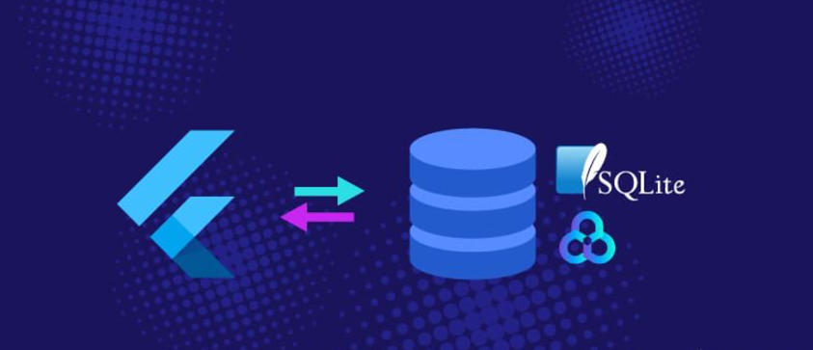
Navigating Local Databases in Flutter

Slide 6
The Necessity of Local Database
An application's data requirements are a crucial factor when deciding the need for a local database.
For apps operating with a large amount of data, a local database can enhance performance by reducing the load time, optimizing the user interface responsiveness, and providing a smoother user experience.
Data persistence is another key benefit of using a local database in Flutter, especially for mobile applications.
Persistent data allows developers to store data directly on the device, enabling app users to access their data offline and at any time, increasing usability.

Slide 7
Evaluating Local Database Options for Flutter
Flutter provides a diverse range of local database options. The choice depends largely on the complexity and scale of the application. Among several options, three stand out for their specific utility:
SQLite: Ideal for complex data structures and relationships. Its support is provided by Flutter's own plugin, SQFlite.
Hive: An efficient and high-performance choice for simpler data structures with its impressive speed and lower resource use.
Shared Preferences: The simplest option is only for storing key-value pairs, suited for persisting light user data-like settings.

Slide 8
Evaluating Local Database Options for Flutter(cont.)
For handling complex databases, Flutter SQLite, supported by the SQFlite plugin, is a popular choice. SQLite is a transactional database engine written in the C programming language. It is an embedded SQL database engine and does not require any separate server process.
For lighter applications, Hive and Shared Preferences are beneficial.
Hive is a NoSQL database written purely in Dart. It’s a perfect fit when dealing with less complex data and when simplicity and speed are critical.
Shared Preferences, on the other hand, is used for storing uncomplicated data in the form of simple key-value pairs, ideal for storing user settings.
Whatever the Flutter database option developers opt for, it is the core part of a Flutter application that helps fuel a seamless UI and enhance the user experience.

Slide 9
SQLite: A Close Study
SQLite is a small, fast, and fully transactional SQL database engine.
Unlike most other SQL databases, SQLite does not operate on a separate server or require any configuration. Instead, SQLite reads and writes directly to ordinary disk files.
This self-contained, high-reliability, embedded, full-featured, public-domain, SQL database engine is the most deployed database in the world with significantly more deployments than Oracle, MySQL, or any other database.
In simpler terms, SQLite provides all the functionality of an SQL database in the most compact and efficient way possible.
It can handle databases of any size and performance is quite good for most common use cases.
SQLite is ideal when working with local databases in Flutter.

Slide 10
SQLite: Benefits in a Flutter Setting
SQLite brings plenty of benefits to a Flutter application:
Serverless and Zero-configuration: SQLite doesn't require a separate server process or system to operate, and it doesn't require setup either. The simplicity of "connect-and-use" saves both time and resources.
Cross-platform compatibility: SQLite engine consists of a library with some C programming files. This makes it compatible with any platform that can work with C, including Flutter.
ACID Compliant: SQLite is fully ACID-compliant, which means it guarantees the Atomicity, Consistency, Isolation, and Durability of the data. This ensures that your database transactions are processed reliably.
Suitable for Offline Apps: SQLite works exceptionally well for applications that need to function offline because it can store data locally.
In the context of Flutter, SQLite is a great choice, especially when dealing with a complex or large amount of data. With the help of the sqflite plugin, Flutter SQLite operations become relatively straightforward and effective.

Slide 11


SQLite Integration in Flutter
Guide: Installation of SQLite in Flutter
To integrate SQLite into a Flutter application, we'll use the sqflite plugin. Below are the steps to install the plugin:
Adding Package: Add the sqflite package in your pubspec.yaml file under dependencies:
Installing Package: Open the terminal in your IDE or command prompt and navigate to your project directory, where pubspec.yaml is located. Run the command flutter pub get to retrieve the packages.

Slide 12

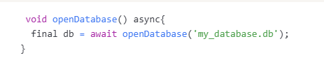
SQLite Integration in Flutter
Flutter SQLite CRUD Operations: A Step-by-Step Guide
With the sqflite package installed, executing various CRUD operations in the SQLite database becomes simplified. Here’s a brief overview of how to perform these operations:
Step 1: Importing Package: Import the sqflite package inside your Flutter Dart file.
Step 2: Opening Database: Use the openDatabase method to open a connection to the database.

Slide 13
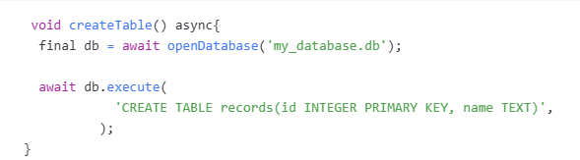
SQLite Integration in Flutter
Step 3: Creating Table: To create a table in your SQLite database, use the execute method after opening the database
The applicability of SQLite in Flutter local databases can streamline your app data handling process, improving performance and resulting in a more responsive user interface.

Slide 14
SQFlite Plugin: A Savior for Flutter Developers
Exploring SQFlite Plugin
SQFlite is a Flutter plugin for SQLite databases. It provides a simple, easy-to-use interface to perform standard database operations like CRUD (Create, Read, Update, Delete).
SQFlite is built exclusively for Flutter, keeping in mind the constraints and operations of mobile devices.
It integrates smoothly with the Flutter ecosystem, hence making it a reliable choice for local storage in Flutter applications.

Slide 15
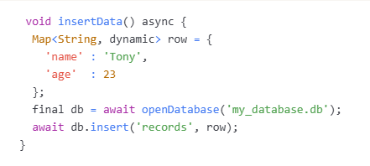
SQFlite Plugin: A Savior for Flutter Developers
Here’s an example that exhibits the database operation of inserting a record:

Slide 16
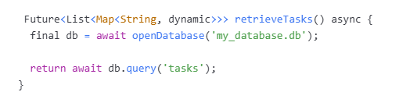
SQFlite Plugin: A Savior for Flutter Developers
Practical Application: SQFlite in a Sample Flutter app
Let's see how Flutter sqflite can be used in a more practical scenario. In this case, we will assume a simple Flutter app that contains a list of tasks. We will use SQFlite to store and retrieve these tasks from the database. Here's a snippet that shows how we can retrieve these tasks from a database:
Using SQFlite, we can easily enhance our applications by adding local storage capabilities. It enables us to create offline-first applications that work irrespective of network connectivity.
SQFlite is undeniably a powerful tool for local storage in Flutter. It simplifies working with SQLite, making data management more efficient and robust, essential for creating user-friendly Flutter applications.

Slide 17
Handling Relationships in SQLite Database with Flutter
SQLite Relationships: Concept Clarification
SQLite follows a relational database model, which means data is stored in tables that can have relationships with one another. There are three main types of relationships:
One-to-One: Each row in table A relates to one row in table B, and vice versa.
One-to-Many/Many-to-One: Each row in table A can link to multiple rows in table B.
Many-to-Many: A combination of Many-to-One and One-to-Many. Rows in table A can relate to multiple rows in table B, and vice versa.

Slide 18
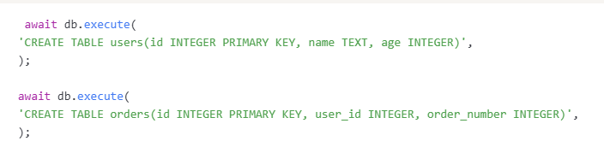
Handling Relationships in SQLite Database with Flutter
Flutter Case Study: SQLite Relationship Implementation
Managing table relationships in Flutter SQLite is straightforward. For instance, suppose we have a user table and an orders table. Here's how we define these tables within SQLite:
In the above example, 'user_id' in the 'orders' table forms a relationship with 'id' in the 'users' table. If you want to retrieve all orders for a particular user, you can execute a JOIN query as follows:

Slide 19
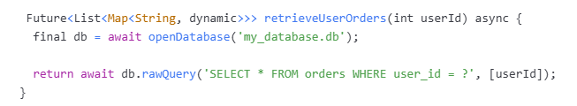
Handling Relationships in SQLite Database with Flutter
In the above example, 'user_id' in the 'orders' table forms a relationship with 'id' in the 'users' table. If you want to retrieve all orders for a particular user, you can execute a JOIN query as follows:
As you can see, SQLite's relational database nature allows efficient management of complex data structures. The ease of Flutter SQLite operations encourages developers to implement relational database designs in their Flutter apps effectively and conveniently.

